Slide 1

Intro to ReactJS & Components
What is React, JSX, Overview and Syntax, Components
SoftUni Team
Technical Trainers
Software University
https://softuni.bg

Slide 2

Table of Contents
React Overview
Installation
JSX Syntax
Components

Slide 3
Have a Question?
sli.do #js-front-end

Slide 4

React Overview
History and Philosophy

Slide 5
What is React.js?
React is a JavaScript library for building user interfaces (UI)
Focused on creating reusable components
Developed by Facebook
const HelloMessage = (props) => (
<div>Hello {props.name}</div>
);
ReactDOM.render(
<HelloMessage name="Maria" />,
document.getElementById('root')
);

Slide 6
Features
Open-source
Declarative
Design simple views for each state in your app
Easier to debug
Component-Based
Encapsulated components that manage their own state
Keep state out of the DOM

Slide 7

React Installation
Packages, Setup, Structure

Slide 8
Create React App
Less to learn - instant reloads help you focus on development
Only one dependency - no complicated version mismatches
No Lock-In - under the hood Webpack, Babel, ESLint
Install the React app creator (one-time global install)

Slide 9
Install and Run the React App Creator
Run the React app creator
Starts your React app from the command line
Browse your app from http://localhost:3000
npx create-react-app my-app
cd my-app
npm start

Slide 10
Finding Information
Visit the official website
Documentation
Online sandbox
https://reactjs.org/
https://reactjs.org/docs/installation.html
https://codesandbox.io/

Slide 11
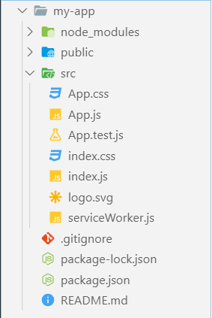
React App Structure
package.json - project configuration
Module name, dependencies, build actions
index.html
App main HTML file
index.js
App main JS file (startup script)
App.js, App.css, App.test.js
React component "App"

Slide 12

Live Demo

Slide 13

JSX Syntax
JSX
Overview, Syntax, Advantages

Slide 14
JSX Syntax
<div className="red">Children Text</div>
<MyCounter count={3 + 5} />
Expression
let gameScores = {
player1: 2,
player2: 5
};
<DashboardUnit index="2" onClick={() => {}>
<h1>Scores</h1>
<Scoreboard className="results" scores={gameScores} />
</DashboardUnit>
Custom component
Pass variable as prop

Slide 15
Live Demo

Slide 16

Components Overview
Syntax, Functional and Class Components

Slide 17
Components Overview
Components let you
Split the UI into independent and reusable pieces
Think about isolation
React let you define components as
Functions
17

Slide 18
Functional Component
Functional component is a JS function which
Accepts single argument called props (object with data)
Returns a React Element
function Person(props){
return <div>My name is {props.name}</div>
}

Slide 19
Component Syntax
Names always start with UpperCase
Tags always must be closed
Information is passed via props
<Dropdown> A dropdown list
<UserHead name="homeHeader" />
<Menu>
<MenuItem>Do Something</MenuItem>
<MenuItem>Do Something Fun!</MenuItem>
</Menu>
</Dropdown>

Slide 20
Shopping Cart Workshop

Slide 21
Questions?
Notes:
21

Slide 22














SoftUni Diamond Partners

Slide 23

Educational Partners

Slide 24
Trainings @ Software University (SoftUni)
Software University – High-Quality Education, Profession and Job for Software Developers
softuni.bg, about.softuni.bg
Software University Foundation
softuni.foundation
Software University @ Facebook
facebook.com/SoftwareUniversity
Software University Forums
forum.softuni.bg
24
Notes:
24

Slide 25

License
This course (slides, examples, demos, exercises, homework, documents, videos and other assets) is copyrighted content
Unauthorized copy, reproduction or use is illegal
© SoftUni – https://about.softuni.bg
© Software University – https://softuni.bg
Notes:
25

